Slide 1

Major Project External Presentation
On
FAKE NEWS CLASSIFICATION USING LSTM
Presented by
SUSHMA SWARAJ K (321810307011)
HARISH KUMAR M L (321810307016)
CHANDRASHEKAR (321810307034)
KARTHIK M.P (321810307050)
Under the guidance of
MRS.KAMALA L
ASSISTANT PROFESSOR,
Dept. of Computer Science & Engineering
GITAM School Of Technology
GANDHI INSTITUTE OF TECHNOLOGY AND MANAGEMENT
(Deemed to be University) Bengaluru Campus.

Slide 2
CONTENTS
Abstract
Introduction
Literature Survey
Problem definition
Objectives
Software requirement specifications
Design
Proposed system architecture
Methodology and Implementation
Results and Discussion
Snapshot of Output received
Acknowledgement
References

Slide 3
ABSTRACT
In recent years, deceptive content such as fake news and fake reviews, also known as opinion spams, have increasingly become a dangerous prospect for online users. Fake reviews have affected consumers and stores alike. Furthermore, the problem of fake news has gained attention in 2018 onwards, especially in the aftermath of the last U.S. presidential elections.Intentionally misleading content presented under the guise of legitimate journalism most so-called 'fake news' is initially distributed over social media conduits like Facebook and Twitter and later finds its way onto mainstream media platforms such as traditional television and radio news. In this project, we will classify whether the news is fake or not using LSTM machine learning algorithm.

Slide 4
INTRODUCTION
Fake News is news, stories, or hoaxes created to deliberately misinform or deceive readers. Usually, these stories are created to either influence people's views, push a political agenda, or cause confusion and can often be a profitable business for online publishers. The purpose of choosing this topic is because it is becoming a serious social challenge. It is leading to a poisonous atmosphere on the web and causing riots and lynching on the road.
Examples: political fake news, news regarding sensitive topics such as religion, covid news like salt and garlic can cure corona and all such messages we get through social media. We all can see the damage that can be caused because of fake news which is why there is a dire need for a tool that can validate particular news weather it is fake or real and give people a sense of authenticity based on which they can decide whether or not to take action, amongst so much noise of fake news and fake data if people lose faith in information, they will no longer be able to access even the most vital information that can even sometimes be life- changing or lifesaving.

Slide 5
LITERATURE REVIEW
SL.NO | Author | Title | Methodoloy | Limitations
01 | Shloka Gilda | Evaluating Machine Learning algorithms for Fake News Detection.(2017) | Shloka Gilda introduced the concept of the importance of NLP in stumbling over incorrect information.They used Bi-Gram Count Vectorizer to detect deceptions. And got a accuracy of 71.2%. | The accuracy of detecting fake news is not even 80% Therefore some news will be predicted as false.

Slide 6
SNO | AUTHOR | TITLE | METHODOLOGY | LIMITATION
02 | Kai Shu, Amy Sliva, Suhang Wang, Jiliang Tang and Huan Liu. | "Fake News Detection on Social Media: A Data Mining Perspective.(2017)" | To detect fake news on social media, a data mining perspective is presented that includes the characterization of fake news in psychology and social theories. In this paper two main factors responsible for the widespread acceptance of fake messages by the user which is naive realism and confirmatory bias. It proposes a general two-phase data mining framework that includes 1) feature extraction and 2) modeling, analyzing data sets, and confusion matrix for detecting fake news | It only focues on the social Media post and feeds.

Slide 7
SNO | AUTHOR | TITLE | METHODOLOGY | LIMITATION
03 | J. Umamaheswari, A. Akila, , Institute Of Electrical And Electronics Engineers, Feb 2019 | "Media Rich Fake News Detection: A Survey. (2018)" | Social networking sites read news mainly in three ways: The (multilingual) text is analyzed with the help of computational linguistics, which semantically and systematically focuses on the creation of the text. Since most publications are in the form of text, a lot of work has been done on analyzing them. Multimedia: Several forms of media are integrated into a single post. This can include audio, video, images, and graphics. This is very attractive and attracts the viewer's attention without worrying about the text. Hyperlinks allow the author of the post to refer to various sources and thus gain the trust of viewers. | It only focues on the social Media post and feeds.

Slide 8
SNO | AUTHOR | TITLE | METHODOLOGY | LIMITATION
04 | Mykhailo Granik and Volodymyr Mesyura | “ Fake News Detection using Naive Bayes classifier. (2019)” | This article describes a simple method of fake news detection based on one of the artificial intelligence algorithms called the Naive Bayes classifier. The goal of the research is to examine how this particular method works for the particular problem with a manually labeled (fake or real) dataset and to support the idea of using machine learning to detect fake news. | Its uses classification algorithm so its does not consider sequential sequential characteristics and use patterns to predict the next likely scenario.

Slide 9
SNO | AUTHOR | TITLE | METHODOLOGY | LIMITATION
05 | Z Khanam, B N Alwasel, H Sirafi and M Rashid | "Fake News Detection Using Machine Learning Approaches" | This paper makes an analysis of the research related to fake news detection and explores the traditional machine learning models to choose the best, in order to create a model of a product with supervised machine learning algorithm, that can classify fake news as true or false, by using tools like python scikit-learn, NLP for textual analysis. | The research in this paper focuses on detecting the fake news by reviewing it in two stages: characterization and disclosure uses qualitative analysis so duration of compilation increases

Slide 10
SNO | AUTHOR | TITLE | METHODOLOGY | LIMITATION
06 | Gaurav Bhatt, Aman Sharma,Shivam Sharma, Ankush Nagpal, Balasubramanian Raman, and Ankush Mittal | "On the Benefit of Combining Neural, Statistical and External Features for Fake News Identification" | In this article they explored a subtask to fake news identification, and that is stance detection. Given a news article, the task is to determine the relevance of the body and its claim. Here they compute the neural embedding from the deep recurrent model, statistical features from the weighted n-gram bag-of-words model and hand crafted external features with the help of feature engineering heuristics. | We found that the uneven distribution of fake news classification dataset leading to lower accuracy

Slide 11
SNO | AUTHOR | TITLE | METHODOLOGY | LIMITATION
07 | Tejaswini Yesugade1, Shrikant Kokate, Sarjana Patil, Ritik Varma, Sejal Pawar | “Fake News Detection using LSTM” 2021 | In this article they hve implemented Machine Learning algorithms and techniques such as NLTK, LSTM. they have introduce the dataset which contain both fake and real news and conduct various experiments to organize fake news detector. We got better results compared to the existing systems. | We found that the uneven distribution of fake news classification dataset leading to lower accuracy

Slide 12
PROBLEM STATEMENT
Fake news is false or misleading information presented as news. Fake news often aims to damage the reputation of a person or entity or make money through advertising revenue.
In a world becoming more and more connected, it is easier for lies to spread. It turns out that it is possible to detect fake news with a dataset consisting of news articles classified as either reliable or not. Artificial Intelligence or Machine learning-based counterfeit news detector is crucial for companies and media to predict whether circulating information is fake or not automatically. In this project, (LSTM) model will be trained to anticipate if the news is classified as authentic or fake.
This hands-on project seeks to detect fake news based on LSTM.

Slide 13
OBJECTIVES
To build a model to recognize fake news using the spacy, and NLTK for Natural Language Processing and Tensorflow, pandas with WordCloud, Seaborn, and Plotty for visualizations libraries and the dataset.
We use the libraries spacy for advanced NLP and sklearn to build a model. That is LSTM, which will recognize text from the dataset by first loading the data, then pre-process the data from it, and converting text to number and then splitting the dataset into training and testing sets. Then, initialize an LSTM and train the model. Finally, the accuracy of the model will be calculated.

Slide 14
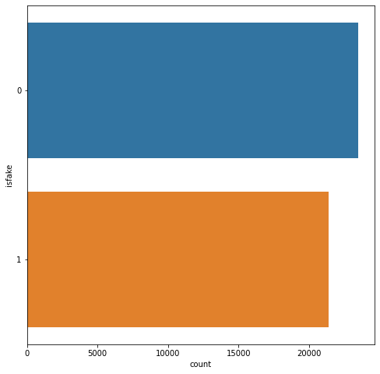
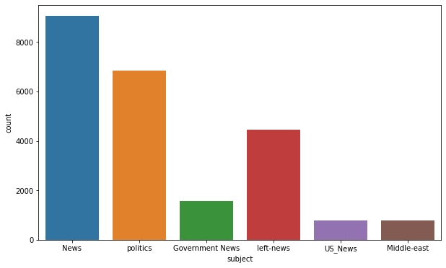
SOLUTION STRATEGY
Data Visualization
Fig 1: Number of sample of subjects in dataset
Fig 2: Fake news vs Real news

Slide 15
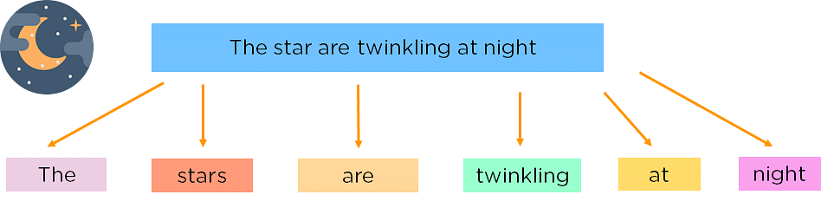
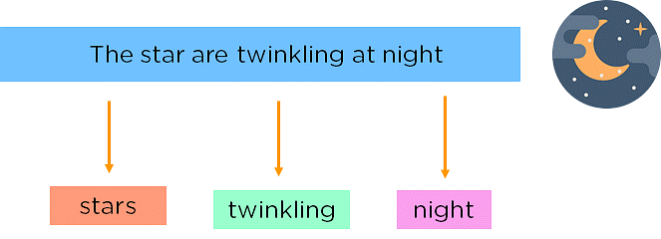
2. Data Pre-processing 2.1 TOKENIZE DATASET
Figure 3: Tokenization
2.2 Stop Word Removal
Figure 4: Stop Words
3. Prepare Train, Validation And Test Dataset 4. Build the model 5. Model Training and Model Evaluation

Slide 16
SOFTWARE REQUIREMENT SPECIFICATIONS
Programming language - Python
ANACONDA 3-64bit
JUPYTER NOTEBOOK OR GOOGLE COLAB
Operating System - any OS like Windows, Ubuntu.
Libraries required: spacy, numpy, sklearn, keras.

Slide 17
PROPOSED SYSTEM ARCHITECTURE
Fig 5: System architecture

Slide 18
METHODOLOGY
1. Install the following libraries with pip: pip install spacy, nltk, numpy, sklearn, tensorflow, pandas with WordCloud, Seaborn. 2. Make the necessary imports: spacy, nltk, numpy, sklearn,tensorflow, pandas, accuracy_score 3. Define a list: Define a list to hold data available in the dataset.
4. Loading Data :
This takes in the relative size of the test set as parameter. x and y are empty lists.
5. Splitting the Dataset :
Split the dataset into training and testing sets where test set is 0.2% of everything and use the load_data function for this.

Slide 19
6. Observe the shape of the training and testing datasets.
7. Initialize an Sequential model.
8. Fit/Train the Model
9. Predict the values for the test set :
This gives us y_pred (the predicted news for the features in the test set).
10. Calculating the Accuracy :
To calculate the accuracy of the model, the function accuracy_score() function is used which is imported from sklearn. After that the accuracy is rounded to 2 decimal places and is printed.
11. Take the input from the user
13. Predicting news on the test data

Slide 20
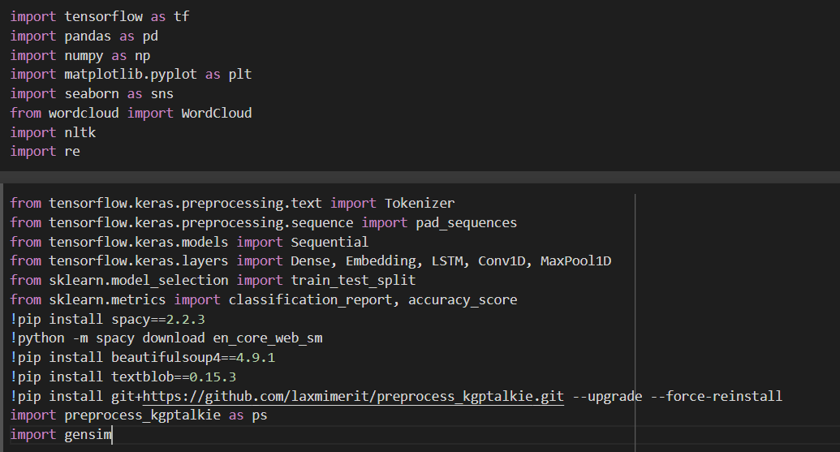
IMPLEMENTATION
1.Making necessary imports
Fig 6: Importing required libraries and modules

Slide 21
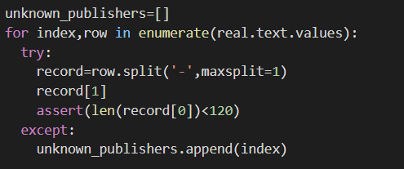

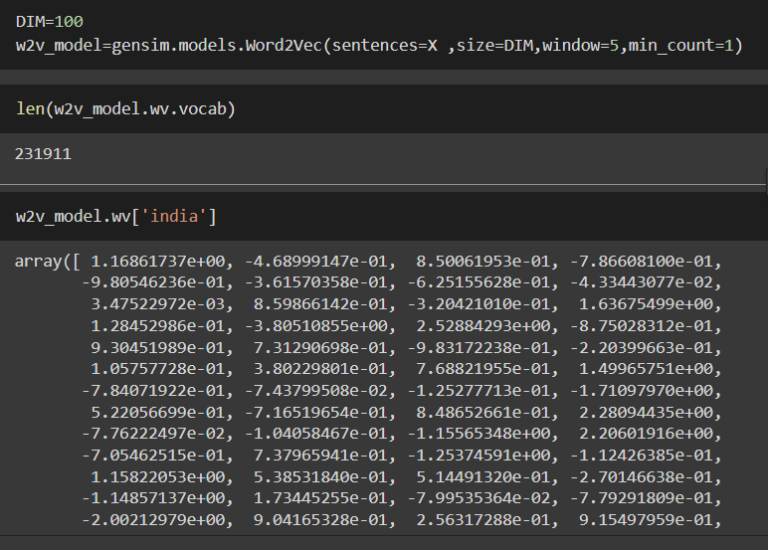
2. Data Pre-processing
Fig 5: Data Preprocessing

Slide 22
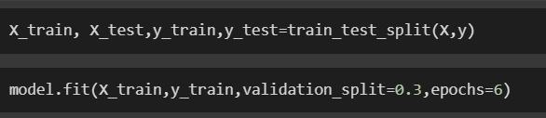
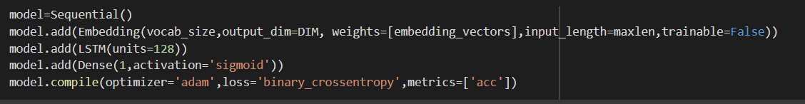
3. Data Splitting and loading Data
Fig 6: Data splitting and loading data
4. Initializing Sequential model and Training
Fig 7: Initialising Sequential model and Training

Slide 23
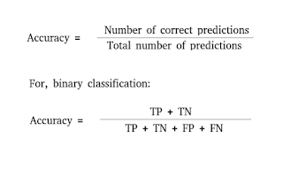
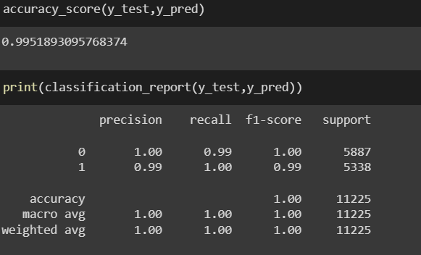
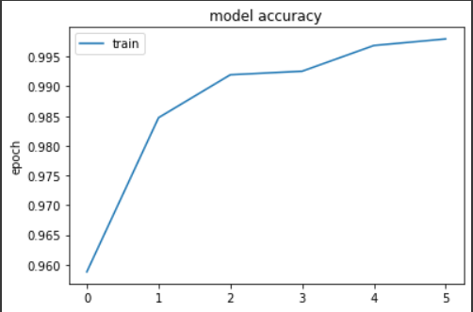
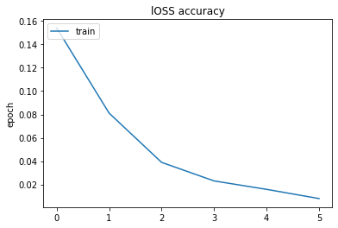
5.Accuracy
Fig 8:Accuracy formula Fig 9: Accuracy of trained model
Fig 10: Accuracy Chart Fig 11: Loss chart

Slide 24
RESULTS AND DISCUSSION
The model was trained and the accuracy of the model were calculated which resulted in an accuracy of 99%. Later when the model tested on the test dataset it successfully classify news as fake or real
The model takes an news text as string for which the model classifies the news as fake or real

Slide 25
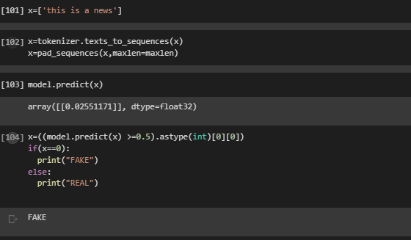
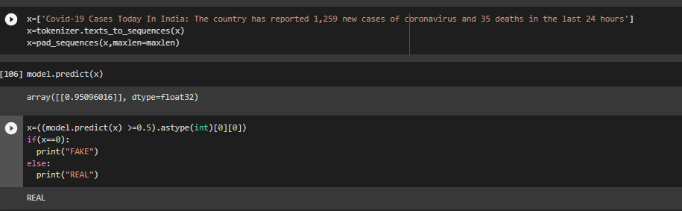
SNAPSHOT OF OUTPUT RECEIVED
Fig 12: Prediction Example 1
Fig 13: Prediction Example 2

Slide 26
ACKNOWLEDGEMENT
The Satisfaction and Euphoria that accompany the successful completion of any Project would be incomplete without mentioning the people who made it possible, whose constant guidance and encouragements crowned our efforts with success. We take this opportunity to express the deepest gratitude and appreciations to all those who held us directly or indirectly towards the successful completion of the Project. I would like to thank Dr. S DINESH, Ph.D., Director, GITAM School of Technology for all the facilities provided. I would like to thank HOD Dr. VAMSHIDAR, Ph.D., Professor-HOD, Department of Computer Science and Engineering for his support and encouragement that went a long way in successful completion of this Project. I consider that as privilege to express our heartfelt gratitude and respect to MRS.KAMALA LF, Assistant professor, department of Computer Science and Engineering for being our internal guide for his integral and incessant support offered to us throughout the course of this project and for constant source of inspiration throughout the Seminar. I would like to thank our parents and our friends for their support and encouragement in the completion of project in time. Last but not least I would like to thank all the teaching and non-teaching staff members of the Computer Science and Engineering Department, for the support in completion of the project in time.

Slide 27
CONCLUSION
In recent years, deceptive content such as fake news and fake reviews, also known as opinion spams, have increasingly become a dangerous prospect for online users. Fake reviews have affected consumers and stores alike. Furthermore, the problem of fake news has gained attention in 2018 onwards, especially in the aftermath of the last U.S. presidential elections.
It turns out this architecture works well for fake news detection. The advantage of LSTM is that the performance time is much shorter, while the performance remains the same. This architecture is useful in other Natural Language Classification tasks as well. The model gives good results in Toxic comment classification as well as sentiment analysis.

Slide 28
REFERENCES
Evaluating Machine Learning algorithms for Fake News Detection.(2017) Author: - Shloka Gilda
Fake News Detection on Social Media: A Data Mining Perspective.(2019) Author: - Kai Shu, Amy Sliva, Suhang Wang, Jiliang Tang and Huan Liu.
Media Rich Fake News Detection: A Survey.(2018) Author:- Shivam B. Parikh and Pradeep K. Atrey.
Ahmed H, Traore I, Saad S. “Detecting opinion spams and fake news using text classification”, Journal of Security and Privacy, Volume 1, Issue 1, Wiley, January/February 2018.

Slide 29
Ahmed H, Traore I, Saad S. (2017) “Detection of Online Fake News Using N-Gram Analysis and Machine Learning Techniques. In: Traore I., Woungang I., Awad A. (eds) Intelligent, Secure, and Dependable Systems in Distributed and Cloud Environments. ISDDC 2017. Lecture Notes in Computer Science, vol 10618. Springer, Cham.
Tejaswini Yesugade1, Shrikant Kokate, Sarjana Patil, Ritik Varma, Sejal Pawar, ‘Fake News Detection using LSTM’ 2021
https://www.kaggle.com/datasets/clmentbisaillon/fake-and-real-news-dataset

Slide 30
THANK YOU FOR YOUR TIME

